Slide 1
Introductory General Chemistry
Chemistry 3A
S. M. Halloran

Slide 2

Math in Chem: Algebra Review
The quantity a
The inverse of the quantity: $\frac{1}{a}=1/a$
The inverse of the inverse takes you back: $\frac{1}{\left(\frac{1}{a}\right)}=a$
$$\frac{\left(\frac{a+b}{c −d}\right)}{\left(\frac{e+f}{g−h}\right)}=\frac{\left(a+b\right)\left(g−h\right)}{\left(c−d\right)\left(e+f\right)}$$
“Implied denominator of 1”. It might help when solving chemistry problems
The number 2.4 = $\frac{2.4}{1}$

Slide 3
Quantities
Number | Unit | Dimension
1 | mile | length (distance)
0.25 | liters | volume
15 | amperes | electric current
A (measured) quantity in science, in chemistry has a number and a unit associated with it
The number is how many/much
The unit is a scale of the measurement, the how many/much of what

Slide 4
Scientific Notation
A way of expressing numerical values
Format: d.mmm × 10^{n}
Part | n.mmm
Part Name | Significand (preferred), Coefficient, (Mantissa is obsolete term)
Part Property | Number greater than or equal to 1.0 and less than 10. This number properly express significant digits
Part | 10^{n}
Part Name | Exponent
Part Property | Exponent of 10 where n is integer, negative, positive (note 10⁰ = 1)

Slide 5
Scientific Notation
decimal point moves to right
1. = 10⁰
10. = 10¹
100. = 10²
decimal point moves to left
0.1 = 10⁻¹
0.01 = 10⁻²
0.001 = 10⁻³
1 atmosphere (atm) = 101,325 Pascals (Pa)

Slide 6
Scientific Notation
Is the number less than 10 and greater than 1?
You don’t really need scientific notation, because it will be [ d.mmm × 10⁰ ] and 10⁰ = 1, so → d.mmm
Otherwise take the number and express as d.mmm
If original number is greater than d.mmm you have to multiply by 10¹ n times to get to original number, so n will be positive (greater than zero): n × 1 = n (greater than zero)
If original number less than d.mmm you have to multiply by 10⁻¹ n times to get to original number, so n will be positive (greater than zero): n × -1 = -n (less than zero)

Slide 7
Scientific Notation
If original number is greater than d.mmm you have to multiply by 10¹ n times to get to original number, so n will be positive (greater than zero): n × 1 = +n
Your book: “if you moved decimal point to the left n places, then n is positive”
35 → 35. → 3.5 moved to left 1 place
3.5 × 10¹
23849 → 23849. → 2.3849 moved to left 4 places
2.3849 × 10⁴

Slide 8
Scientific Notation
If original number less than d.mmm you have to multiply by 10⁻¹ (or divide by 10) n times to get to original number, so n will be negative (less than zero): n × -1 = -n
Your book: “if you moved decimal point to the right n places, then n is negative”
0.0000035 → 3.5 moved to right 6 places
3.5 × 10⁻⁶
0.023849 → 2.3849 moved to right 2 places
2.3849 × 10⁻²

Slide 9
Scientific Notation
Patterns for memorizing
decimal point movement – number being changed – final exponent value
Left – Large – Positive
Right – Small – Negative
Positive and negative for exponent, not significand!
34249 → 3.4249 × 10⁴
-34249 → -3.4249 × 10⁴
0.0034249 → 3.4249 × 10⁻³
-0.0034249 → -3.4249 × 10⁻³

Slide 10
Scientific Notation
Scientific notation is actually a product of two numbers: the significand and a power of 10!
34249 = 3.4249 × 10⁴ = 3.4249 × 10,000 = 34249
-34249 = -3.4249 × 10⁴ = -3.4249 × 10,000 = -34249
0.0034249 = 3.4249 × 10⁻³ = 3.4249 × 0.001 = 0.0034249
-0.0034249 = -3.4249 × 10⁻³ = -3.4249 × 0.001 = -0.0034249
Use this feature to confirm whether you converted a number to scientific notation properly!

Slide 11
Significant Digits
Significant digits indicate the precision, the confidence of a single measurement
Also called significant figures
Measurement/Value | Significant Digits | Explanation
1.7 | 2 | All non-zero digits significant
1.732 | 4
17.32704 | 7 | Zeroes between non-zero digits are significant

Slide 12
Significant Digits
Measurement/Value | Significant Digits | Explanation
0.0045 | 2 | leading zeroes after decimal point not significant
0.00450 | 3 | trailing zeroes after decimal are significant
1200 | 2
1200. | 4 | assertion of decimal point makes significant
0.000 | 0 | no non-zero digits at all
1000.0 | 5 | adding decimal point and any zeroes after it makes all digits significant
100 | 1 | evaluated like the “1200” example above
1.200 × 10⁻³ | 4 | all digits in scientific notation should be significant

Slide 13
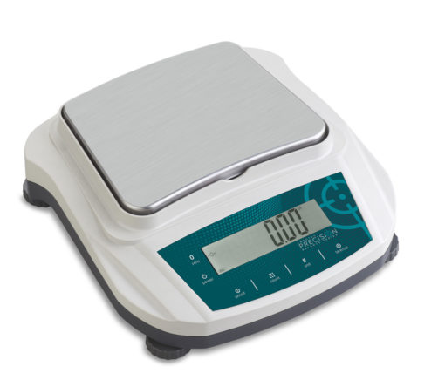
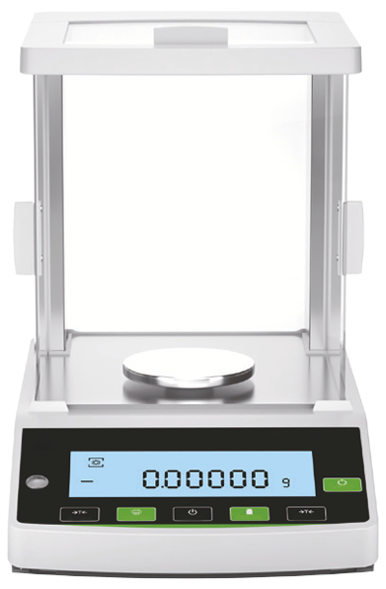
Significant Digits
Significant digits indicate the precision, the confidence of a single measurement
Preparative balance
Measuring quantities usually 0.1 g (100 mg) or greater
used to weigh masses for starting a chemistry experiment
Precision example: 3.4 g sodium chloride (NaCl)
Analytical balance
Measuring quantities usually down to 0.0001 g (0.1 mg or 100 µg) or greater
used to weigh masses for determining yield of product at end of a chemistry experiment
Precision example: 0.0241 g copper(II) sulfate pentahydrate

Slide 14
18 ≠ 18. ≠ 18.0 ≠ 18.00
They are all mathematically equal to 18
But they are not the same in terms of the precision or certainty of the value
18 ➔ 2 significant digits: ±1
18. ➔ also 2 significant digits: ±1
But the measuring device will show decimals
18.0 ➔ 3 significant digits: ±0.1
18.00 ➔ 4 significant digits: ±0.01

Slide 15
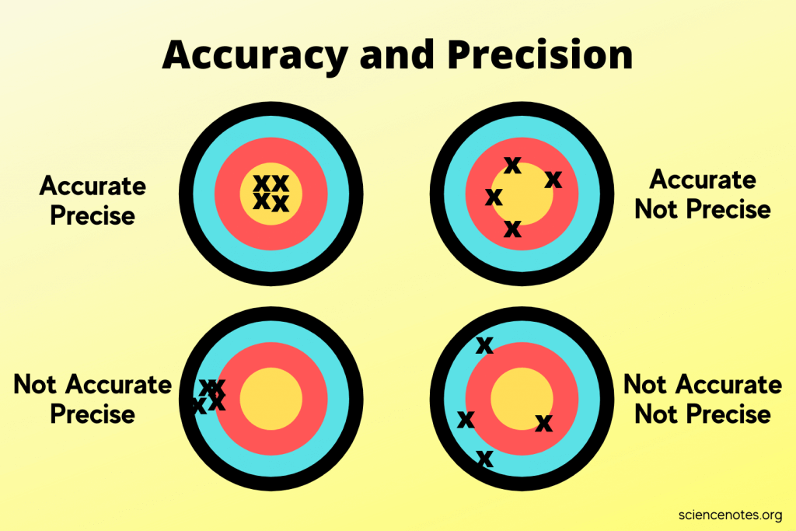
A Slight Tangent on “Precision”
Multiple Measurements
Precision – an indicator of how measurements repeat the value being measured
Accuracy – an indicator of how measurements get to the true value

Slide 16
Significant Digits in Scientific Notation
The rules on significant digits in numerical values always apply in scientific notation
2.69 × 10⁻⁵ = 0.0000269 (3 significant digits)
2.69000 × 10⁻⁵ = 0.0000269000 (6 significant digits)
2.69 × 10³ = 2690 (3 significant digits)
You still have add the zero to get standard form of number as integer
2.69000 × 10³ = 2690.00 (6 significant digits)

Slide 17
Doing Math
Addition and Subtraction of Numbers with Different Significant Digits
Solve 12.11 + 18.0 + 1.013 =
Solve 100.29 – 2.343 – 72.9 =
Solve 1000.23 – 87.532+ =
 |  |  |  | Result
 |  |  |  | Calculator's Display | Your Answer
Value | 12.11 | 18.0 | 1.013 | 31.123 | 31.1
Decimal Places | 2 | 1 | 3 | 3 | 1
 |  |  |  | Result
 |  |  |  | Calculator's Display | Your Answer
Value | 100.29 | 2.343 | 72.9 | 25.047 | 25.1
Decimal Places | 2 | 1 | 3 | 3 | 1

Slide 18
Doing Math
Multiplication and Division of Numbers with Different Significant Digits
Solve 12.11 + 18.0 + 1.013 =
Solve 100.29 – 2.343 – 72.9 =
Solve 1000.23 – 87.532+ =
 |  |  |  | Result
 |  |  |  | Calculator's Display | Your Answer
Value | 12.11 | 18.0 | 1.013 | 31.123 | 31.1
Decimal Places | 2 | 1 | 3 | 3 | 1
 |  |  |  | Result
 |  |  |  | Calculator's Display | Your Answer
Value | 100.29 | 2.343 | 72.9 | 25.047 | 25.1
Decimal Places | 2 | 1 | 3 | 3 | 1

Slide 19
Doing Calculations: NO INTERMEDIATE ROUNDING!!!
Simple example
Calculate the cost of carpeting a 4.8 m x 3.2 m floor where the carpeting costs $42 per square meter
You do the calculation in steps:
The area: 4.8 m × 3.2 m = 15.36 m² (value on calculator display)
Finishing off
rounding no decimal: 15 m² × ($42 / m²) = $630.00
rounding to one decimal: 15.4 m² × ($42 / m²) = $646.80
no rounding: 15.36 m² × ($42 / m²) = $645.12
No need for intermediate result determination in nearly all cases
4.8 m × 3.2 m × ($42 / m²) = $645.12
In business accounting & chemistry, do the rounding at the end of the calculation. To significant digits

Slide 20
EDIT NEXT

Slide 21
Doing Math
Addition and Subtraction of Numbers with Different Significant Digits
Rules of Multiplication and Division

Slide 22
“Conversion Factors”
Calculations in chemistry frequently require converting between the units of a quantity
Volume: fluid ounces to milliliter (“fl oz” to “ml”)
Temperature: Celsius to Kelvin (“°C” to “K”)
Pressure: torr to atmosphere (“torr” to “atm”
Conversions not just about measurement systems but also include scales which are powers of 10
1 liter (L) = 1000 milliliters = 1000 mL
not 1000 ml! use SI unit lettering case
1 kilogram (kg) = 1000 grams (g)

Slide 23
Conversion Nomenclature
Prefix | Meaning | Example
Multiple of 10 (greater than 1)
kilo- (k) | 10³ = 1000 | 2 kilograms (kg) = 2000 grams
mega- (M) | 10⁶ = 1,000,000 | 3.7 megajoules (MJ) = 3,700,000 J
giga- (G) | 10⁹ = 1,000,000,000 | 10 gigahertz (GHz) = 10,000,000,000 Hz
Submultiples of 10 (fractions of 1)
deci- (d) | 10⁻¹ = 1/10 | 1 deciliter (dL, dl) = 0.1 L
centi- (c) | 10⁻² = 1/100 | 2.54 centimeter (cm) = 0.0254 m
milli- (m) | 10⁻³ = 1/1000 | 14 millibar (mbar) = 0.014 bar
micro- (u/µ) | 10⁻⁶ = 1/1000000 | 259 microliters (µl, ul, µL, uL) = 0.000259 L
nano- (n) | 10⁻⁹ = 1/1000000000 | 34 nanograms (ng) = 0.000000034 g
pico- (p) | 10⁻¹² = 1/100000000000 | 250 picoliters (pL) = 0.00000000025 L
femto- (f) | 10⁻¹⁵ =1/ 1000000000000000 | 4.3 femtomoles (fmol) = 0.0000000000000043 mol
units in green are often used in chemistry

Slide 24

Density
How much mass is in a given volume
The math definition:
Greek letter rho (ρ) is symbol for density
$$density= \frac{mass}{volume}$$
$$ρ=\frac{m}{V}$$

Slide 25
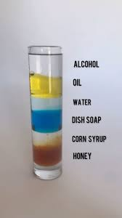
Densities of Natural Substances
Table 1.4.1: Densities of Common Substances
Substance | Density at 25°C (g/cm3)
blood | 1.035
body fat | 0.918
whole milk | 1.030
corn oil | 0.922
mayonnaise | 0.910
honey | 1.420

Slide 26
Problem Solving Process Using Density
The problem/question (from your book)
A mercury thermometer for measuring a patient’s temperature contains 0.750 g of mercury.
What is the volume of this mass of mercury?
The most important thing you will ever do is to spend the time and effort to fully understand the question, and identify the key elements of it
Look for what is asked for: volume of mercury
Look for what is given: a mass (0.750 g) of mercury

Slide 27
Problem Solving Process Using Density
What is missing from the information given in the problem/question?
Usually the information not given are constants of nature and (numerical) properties of matter and energy like atomic weights. In this case, it is a density.
The density of a substance is a property that allows you to relate its mass to its volume and vice versa
The density of water is 1 g/mL (at 0°C) and is a property of water
The density of mercury is 13.6 g/mL

Slide 28

Problem Solving Process Using Density
For this equation about density, this is all just algebra below which you already know
$ρ=\frac{m}{V}$ ➔ $V×ρ=m$ ➔ $V=\frac{m}{ρ}$ $=$ $\frac{1}{ρ}$ $×m$
In the last manipulation, we have an expression that tells us what the volume is equal to: the inverse of the density multiplied by the mass, or “mass over density”

Slide 29
Temperature
A measure of the average kinetic energy of particles in a substance
Not energy itself, but an indicator or measure of energy

Slide 30
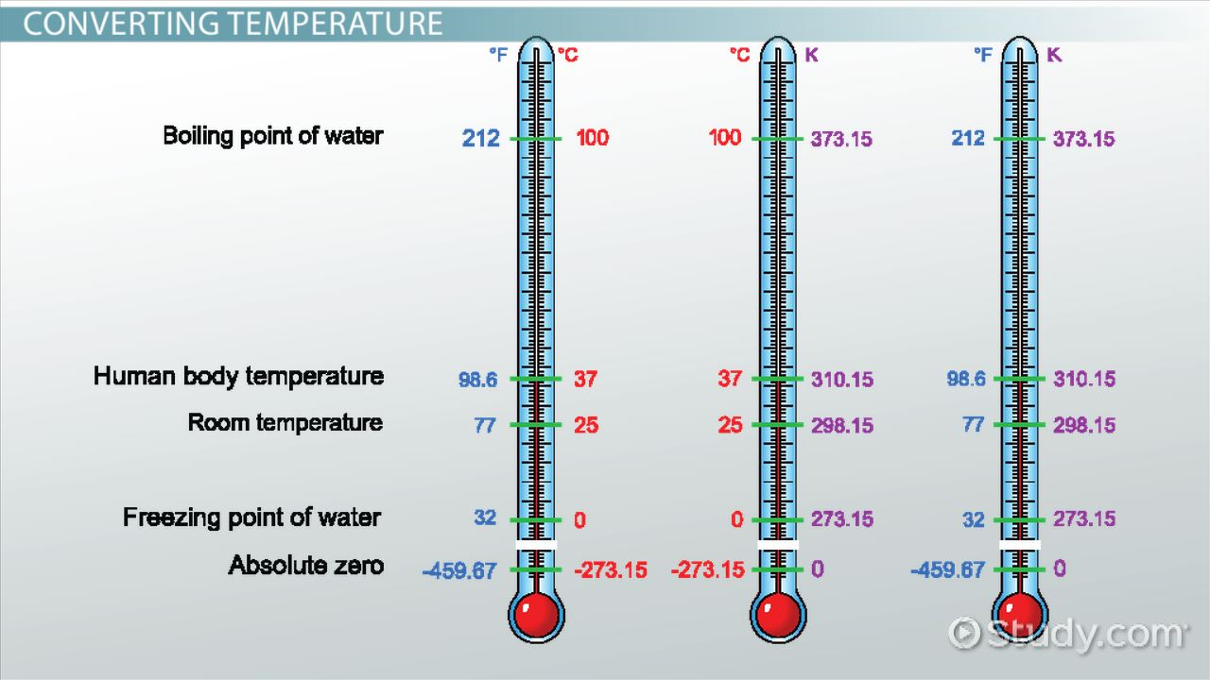
Measuring Temperature
image from Study.com

Slide 31
Temperature Scales
Three scales (measurement types) are used to get a value of temperature
Thermometers usually involve expansion or contraction of calibrated sealed tube of mercury (Hg) or dyed-alcohol
Scale | Water Property
 | freezing point | boiling point
Fahrenheit | 32° F | 212° F
Celsius (centigrade) | 0° C | 100° C
Kelvin | 273 K | 373 K

Slide 32




Converting Temperature
Conversions apply basic algebraic principles of sloped lines
s$\text{lope} =\frac{373 −273}{100 − 0}$ = 1
$$°C =K −273$$
2$73 =1 ×0+\text{intercept}$
Intercept = 273
K$=°C+273$

Slide 33


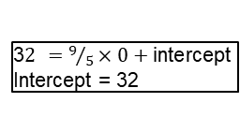

Converting Temperature
Fahrenheit not used in chemistry, but be prepared to convert
s$\text{lope} =\frac{212 −32}{100 − 0}=\frac{180}{100}=\frac{9}{5}$
$$°C =\frac{5}{9}\left(°F −32\right)$$
3$2 =9/5×0+\text{intercept}$
Intercept = 32
°$F =\frac{9}{5}°C+32$

